Slide 1
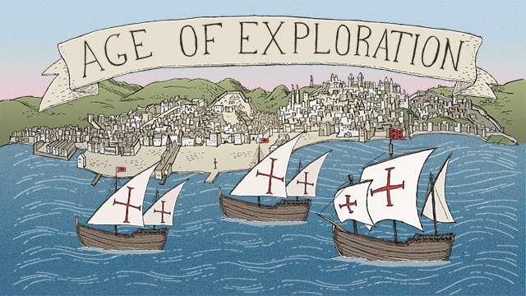
Age of Exploration
Chapter 19 #1

Slide 2
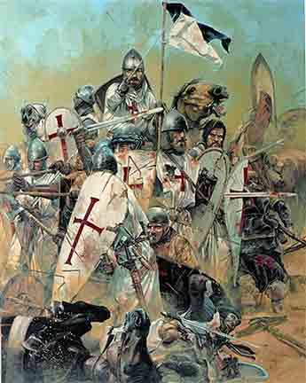
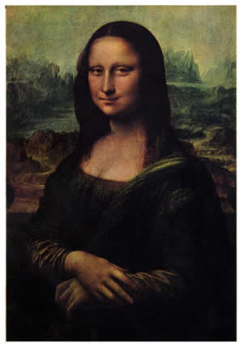
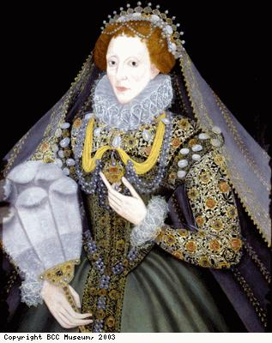
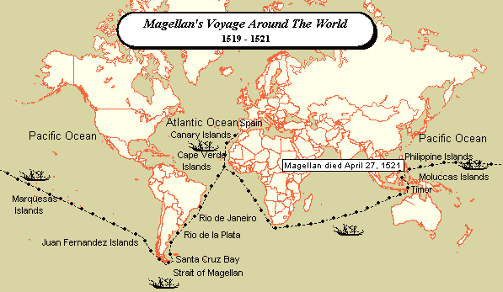
European Societies 1492
Communities based on a hierarchy- 1.Monarchs and nobles 2. Merchants, artisans 3. Peasants
Few moved beyond the position they were born.
Roman Catholic Church was the dominant religion. Crusades fought for the holy land of Jerusalem.
Decline in the church – Reformation. Catholics vs. Protestants.
Renaissance- Rebirth of human society, realism and individual achievement.
Age of Exploration- 3 G’s gold, god and glory

Slide 3
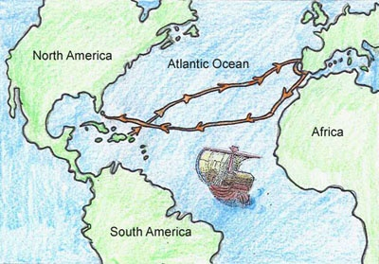
First Encounters
1492 Christopher Columbus stood before the Spanish court with a plan for a route to Asia by sailing across the Atlantic Ocean for an alternate trade route.
Nina, Pinta and Santa Maria set sail
The 70th day in October,1492 the 90 explorers landed on one of the islands of the Caribbean.
Came across the Taino’s and claimed the land Spain’s.

Slide 4
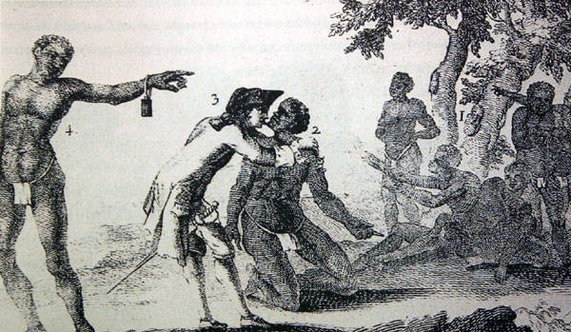
Gold, Land, and Religion
Gold was a main reason for exploration. Spent 96 days exploring the Bahamas and Caribbean Islands. Columbus thought he was in what we know as China and Japan. Which he claimed for Spain. Naming the people Los Indios.
Forced religion on the people and took all possessions.
Columbus left back to Spain convinced he landed in Asia . Monarchs funded 3 more voyages. Including 17 ships, several hundred armed soldiers, priests and a 1,000 colonist.
Divided Haiti and the Dominican Republic started a lasting feud.

Slide 5
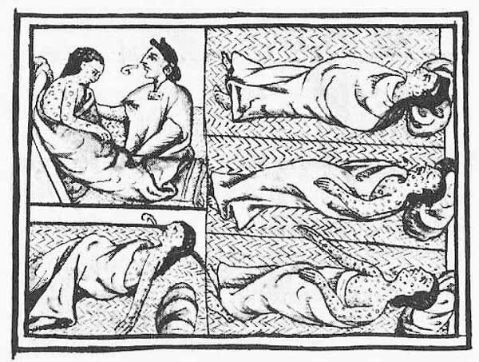
The Impact on the Native Americans
Native Americans were not immune to disease and viruses that the Spanish brought. Caused death to thousands. Small pox, measles, mumps, chicken pox, and typhus (bacterial disease caused by lice.)
Colonization process of plantations, forced labor, and weapons.
Natives revolt but could not save selves from Spanish rule.

Slide 6
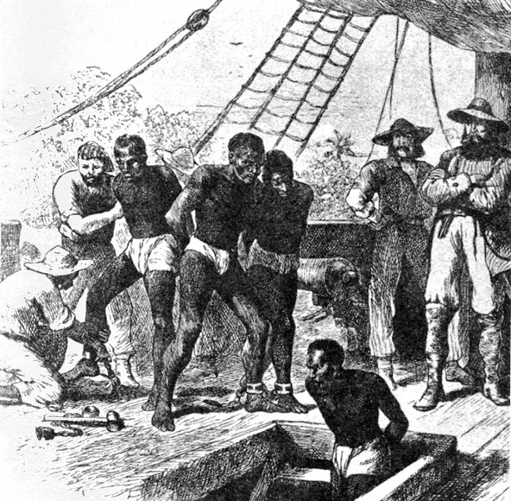
Slave Trade Begins
With diseases reducing the number of natives for work, Europeans turned to Africa for slaves. African slavery became an essential part of the European-American economic system. Drained Africa of 12 million people.

Slide 7
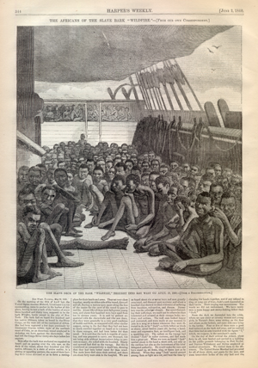
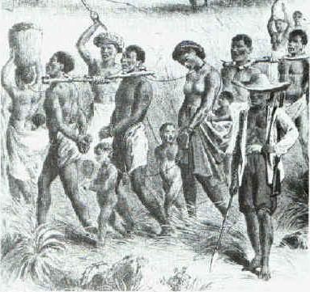
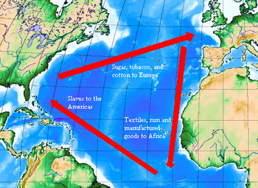
Slave Trade
Triangular trade – network to increase finances
Over 400 years 25-30 million slaves were transported
Middle passage –cruel journey, branded, whippings, beatings, chained, disease, vomit and waste. 16-20 weeks
Africans committed suicide, died of disease or sold into slavery once in North America– network to increase finance

Slide 8
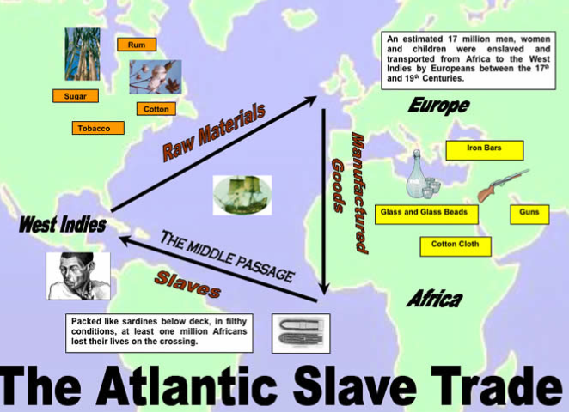

Slide 9
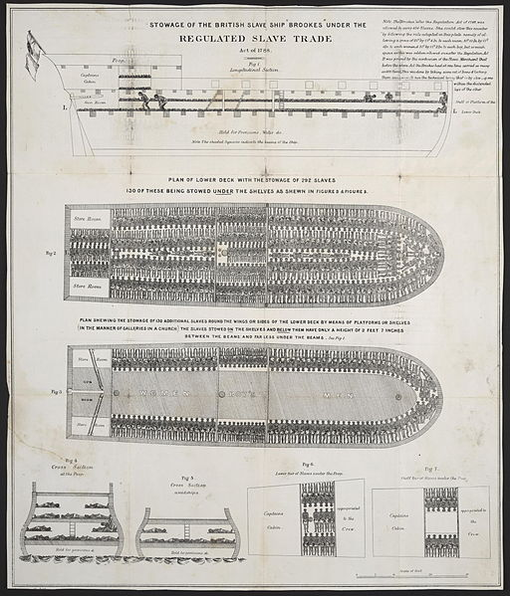
British Slave Ship

Slide 10
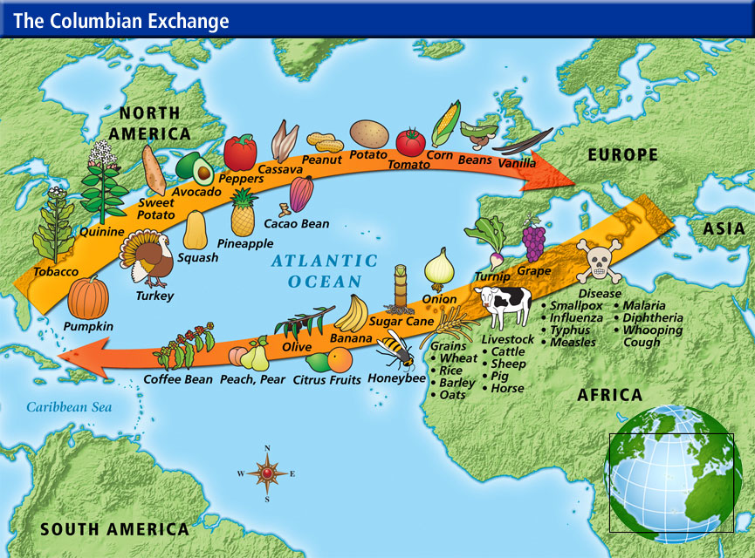
Columbian Exchange 1492- Present
Merchants, monarchs and ordinary people saw opportunity to increase their wealth and influence.
Columbian Exchange- Introduction of new plants and animals to Europe, Africa and the Americas. Became one of the words largest voluntary migrations in history.

